Slide 1
Data Science Methods for Cutting Edge Research
Machine Learning Introduction and Classification

Slide 2
Motivation
You have some computational assessment of various elements. Using a combination of the data, you can see a clear relationship classification of the elemental category
How would you use this information to make predictions about the classification of other elements?

Slide 3
Outline
Overview of key terms/vocab in ML
Types of learning / modeling
Different models, different purpose(s)
Types of data
Evaluating your models
Classification methods
KNN + Python practice
Logistic regression
Figures and notation will follow Introduction to Statistical Learning unless otherwise noted; see #dsmcer for more info or Google for free pdf of book

Slide 4
Concepts: Types of learning and purpose of learning (basic terminology)
Differentiating “statistical learning” vs “machine learning”
Differentiating “supervised” vs “unsupervised”
Differentiating “prediction” vs “inference”

Slide 5
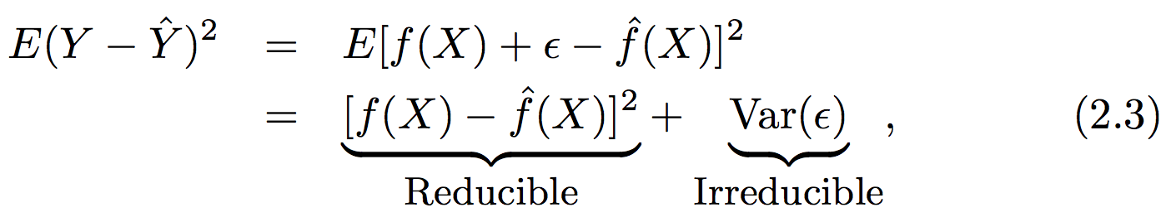
Some concepts about supervised learning (basic terminology)
In supervised learning we assume there is a functional form that can describe our output vector (Y) given some input vector (X)
We are concerned with estimating a function that can predict an output given a certain set of inputs
There are two limits to the error in our function
“E()” is the expectation value or average squared error
Notes:
Eps is random error

Slide 6
Some concepts about supervised learning (functional form)
Some models have a defined functional form over the entire range of input values (parametric modeling)
We assume a functional form (parameters or coefficients)
We determine the parameters by minimizing the error between the model and reality for some subset of our data (fitting or training)
Some models do not assume a defined functional form – the goal is just to get as close as possible to the data (non-parametric modeling)
There is still a model fitting procedure; the model still has some information content that is determined from your data
In parametric modeling you risk overfitting especially with noisy data. In non-parametric models you require much larger training data sets

Slide 7
Some concepts about supervised learning (I/O type )
In supervised learning, some models deal with the prediction of a numerical output given some inputs: regression problems
See if you can come up w/an example of where regression would be useful in materials / energy science
On the other hand, some models deal with the prediction of whether some object (defined by X) is a member of a certain group (or class): classification problems
See if you can come up w/an example of where classification would be useful in a problem related to social science
Some methods (e.g., KNN) can be used for regression purposes and classification purposes! Weird!

Slide 8
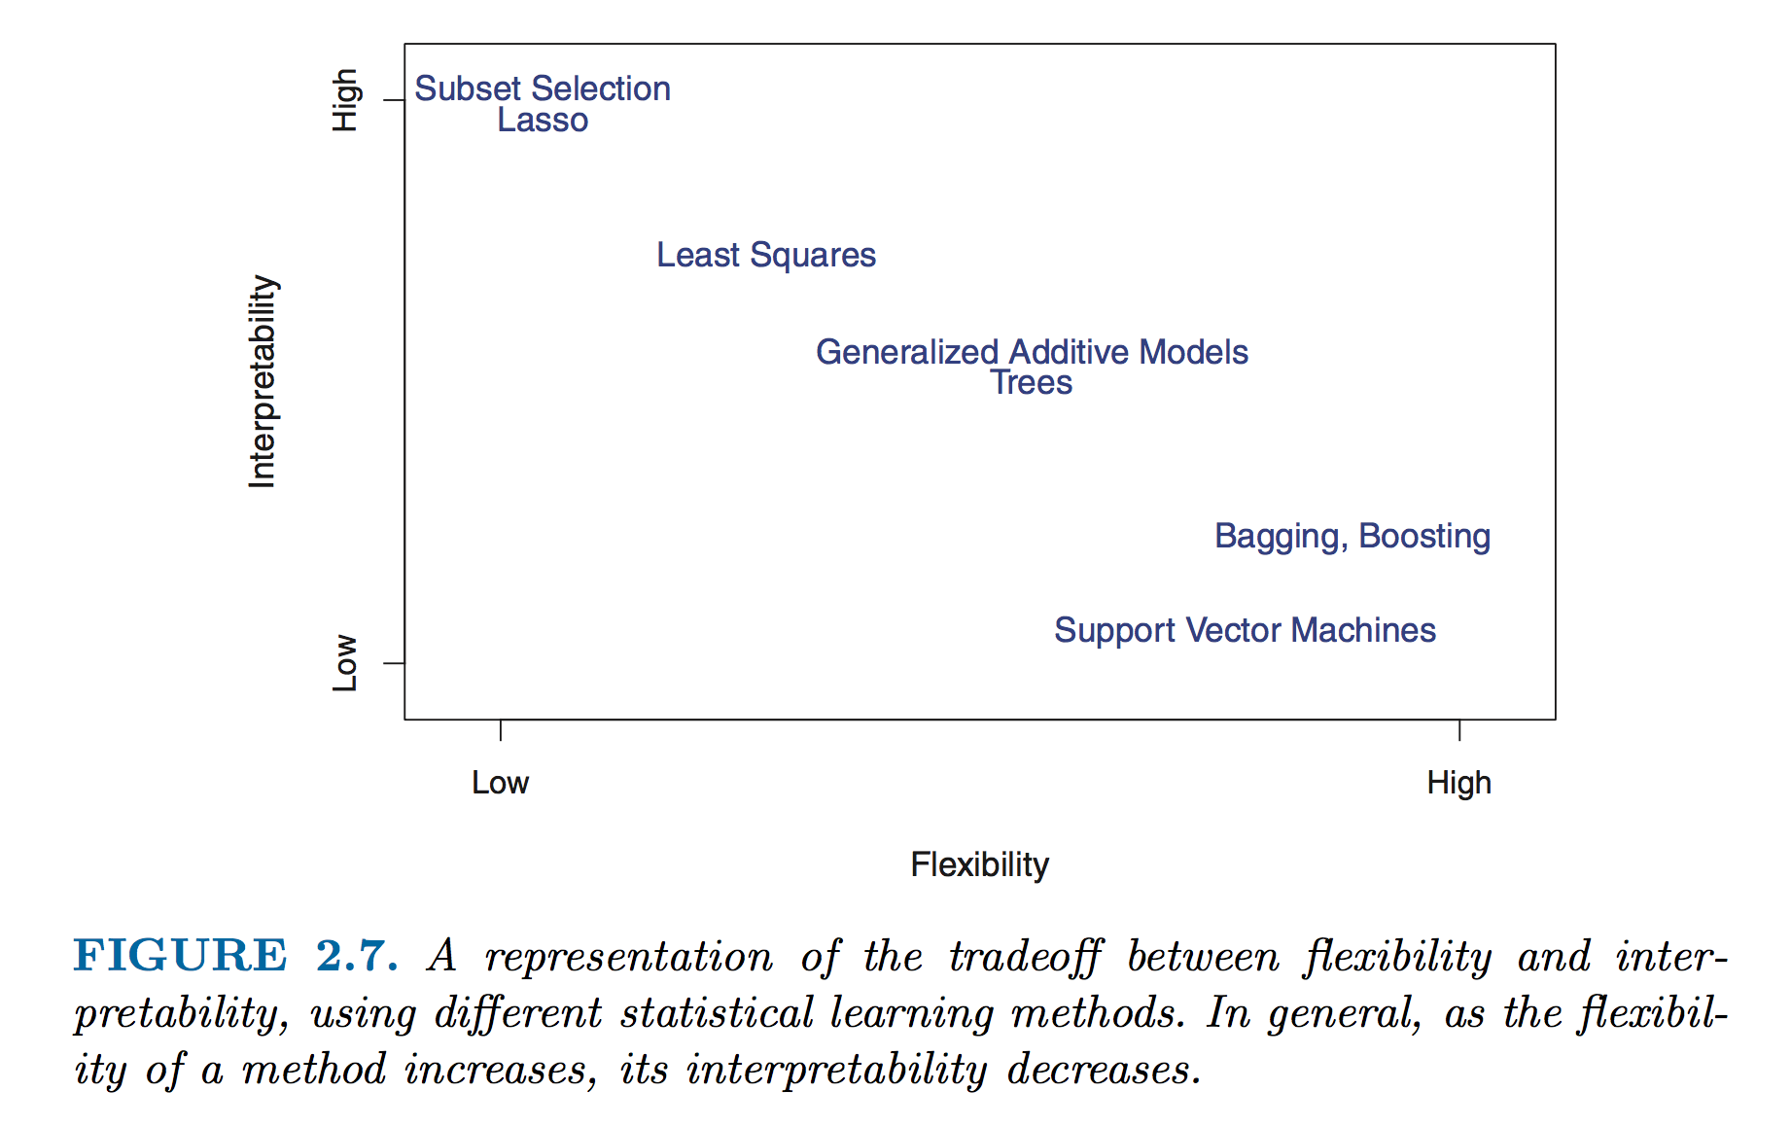
Basic Concepts about flexibility and interpretability

Slide 9
Data: Types of data and purpose
Supervised learning problems always require a set of data that must be used to train your model
Remember: model training means we are finding the minimum error between our predicted outputs and measured outputs (Ŷ vs Y)
We always want to know how our model is doing “out in the real world” on some data that the training process was blind to (validation)
Do unsupervised learning models need training and validation sets?

Slide 10
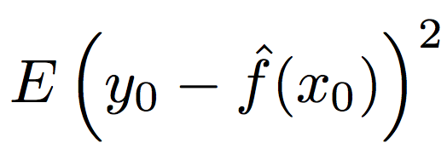
Assessment: Measuring model accuracy (regression)
The MSE as an estimator
Challenges with the MSE and why we need other estimators
Side conversation: Why is it squared error?
Does anyone know why we can’t use the MSE in classification problems?

Slide 11
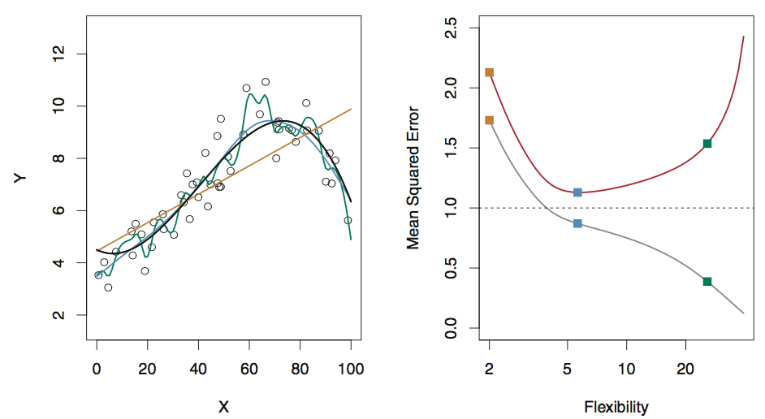
Assessment: Comparing models in linear regression
The true functional form is given w/the black curve
Compare errors in the training data from three test functions (orange, green, blue) [grey curve, right]
Compare errors in the testing data from the three test functions [red curve, right]
Fig 2.9, ISL

Slide 12
Assessment: Bias and variance
Ultimately we care about the true expectation value of the error of our model (given infinite testing data)
The variance in the error shows us how much the error changes if we estimated f with a different set of training data (e.g., consider fit w/many splines)
The bias in the error shows us how much error is introduced by the simplicity of our model (e.g., curvy data w/linear fit)
The total MSE can never fall below the variance in our observations! (irreducible error)

Slide 13
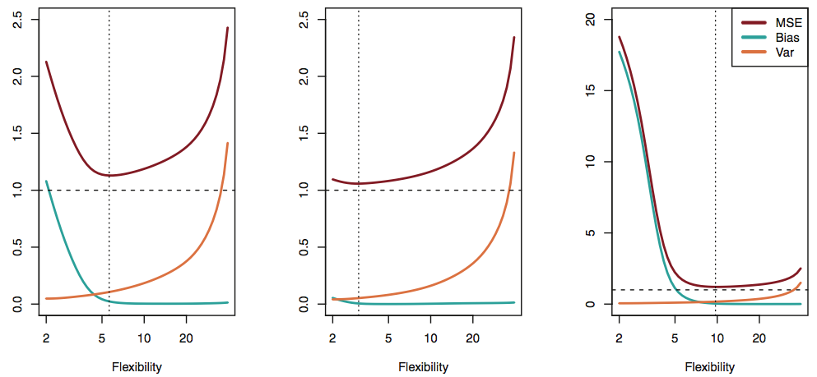
Bias and variance: the tradeoff
In practice, the bias error is difficult to estimate quantitatively, but the principle is critical to qualitatively understand!
See figs 2.9-2.11 and full version of Fig 2.12 in ISL for more examples!
Modified Fig 2.12, ISL

Slide 14
Assessment: Errors in classification problems
Even though we aren’t making a quantitative prediction, we still need to assess the model accuracy
Consider the frequency of incorrect classification, the error rate
The training error rate is the frequency of errors on our training data
Generally more interested in the test error rate, errors on data that were not used to train our classifier

Slide 15
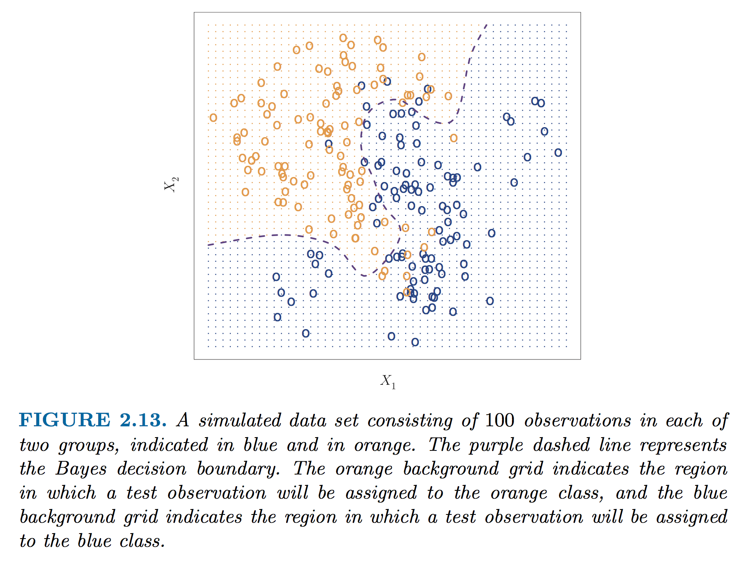
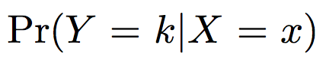
An estimator for the irreducible error in classification: Bayes classifier
My first classifier!
In principle if we know the true conditional probability distribution for our data, we can construct a surface (a decision boundary) that guarantees our error rate in classification is minimized
This ideal model is the “Bayes classifier” and this boundary is the “Bayes decision boundary”
Brief discussion of decision boundaries, visualization of classification models, and a warning about dimensionality!

Slide 16
Transition from ML overview!
Any questions / concerns
If people are really bored, someone could ask me to tell a joke right now

Slide 17
Classification methods
[quick warmup?] Examples of classification problems in materials or molecular science?
We will cover two types of classification methods in this class:
k Nearest Neighbors (often KNN)
Making a map of parameter space and estimating the class membership based on locality to other members of the class
Logistic regression
Making a mathematic guess about the likelihood of class membership using a simplified mathematical model (the logistic function)

Slide 18
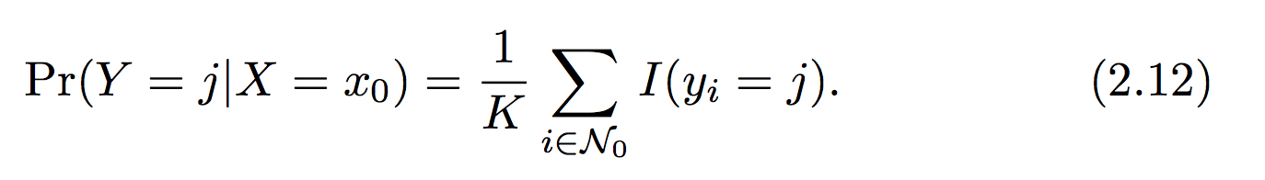
(probably) the simplest classification method is k-nearest neighbors (KNN)
The KNN classifier works on assigning the probability of membership in a class based on distance to other members in a class
Simple, right?
Our selection is based only on K – the number of neighbors we consider
What are the possible ranges of K?
The KNN classifier

Slide 19
A note about distances and identifying who is “nearest” ?
In this example, and all others we looked at and discussed you all made a key assumption (without realizing it) when you were identifying neighbors
The data in each dimension of X should be scaled similarly!
We are concerned with relative distances in the parameter space, not absolute distances in the underlying units
Otherwise units, dimensionality, etc. can drastically favor closeness in arbitrary dimensions of X

Slide 20
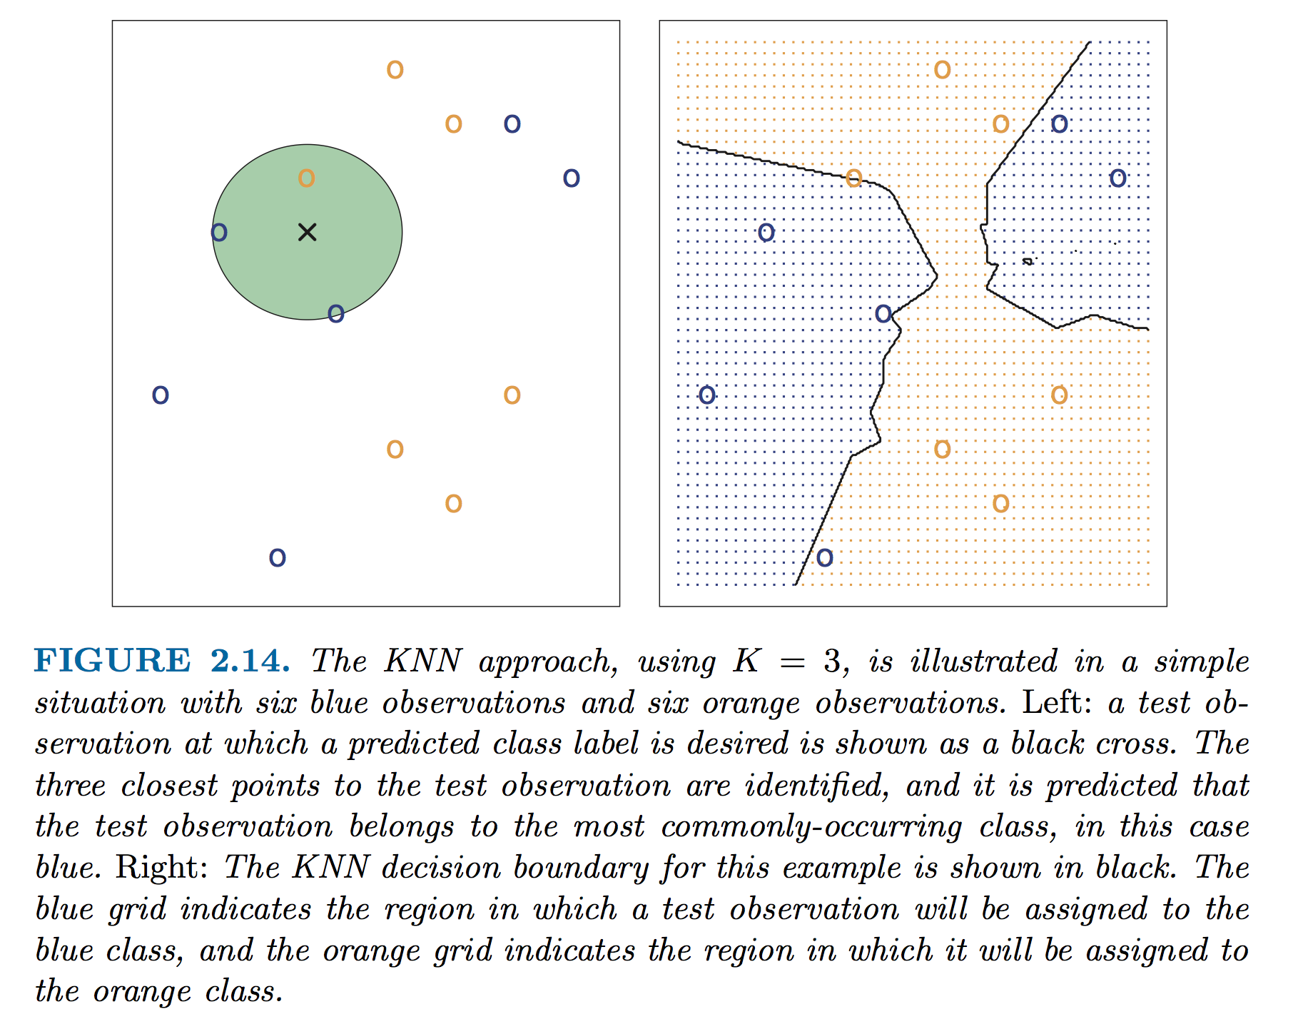
Illustration of KNN

Slide 21
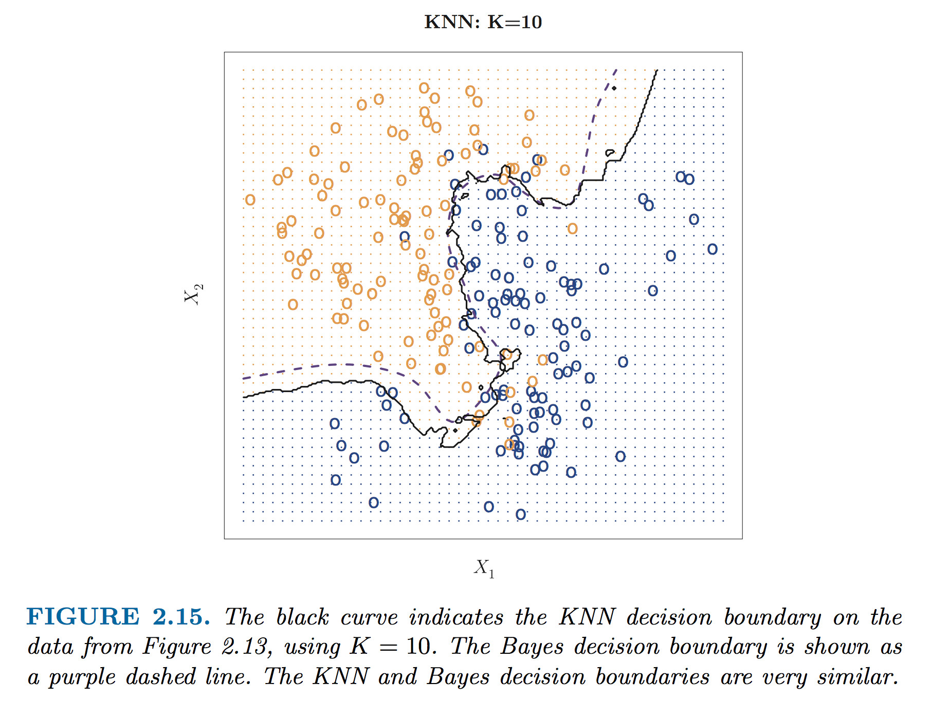
Effect of K on boundary

Slide 22
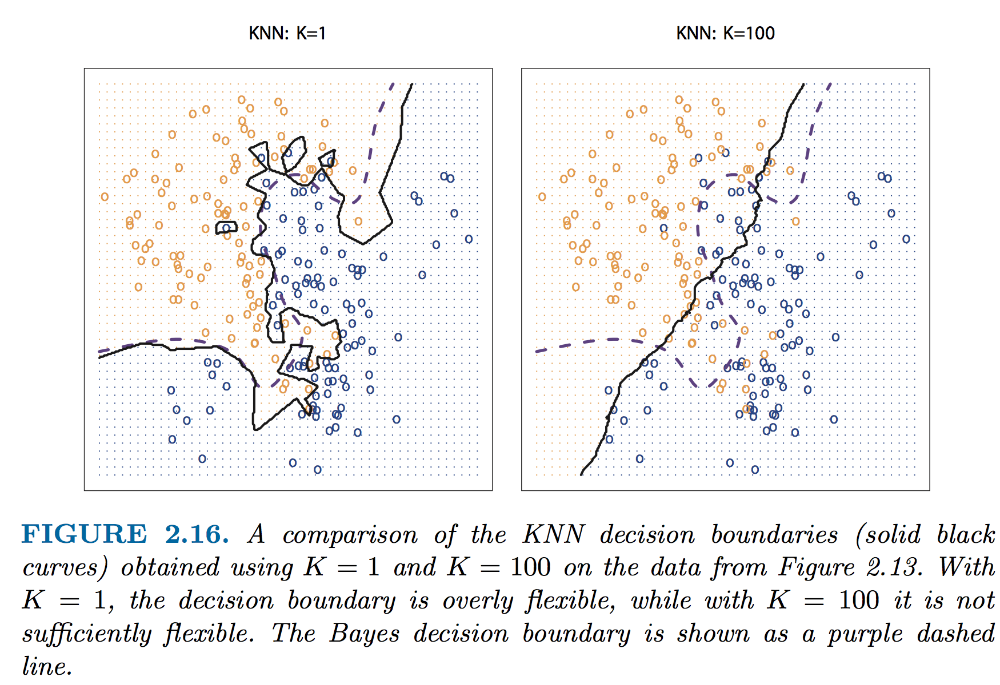
K too big or too small: noise and accuracy
Notes:
Why does this matter? Look @ islands w/K=1 and effect of noise! – look @ loss of flexibility w/ K=100 and loss of accuracy

Slide 23
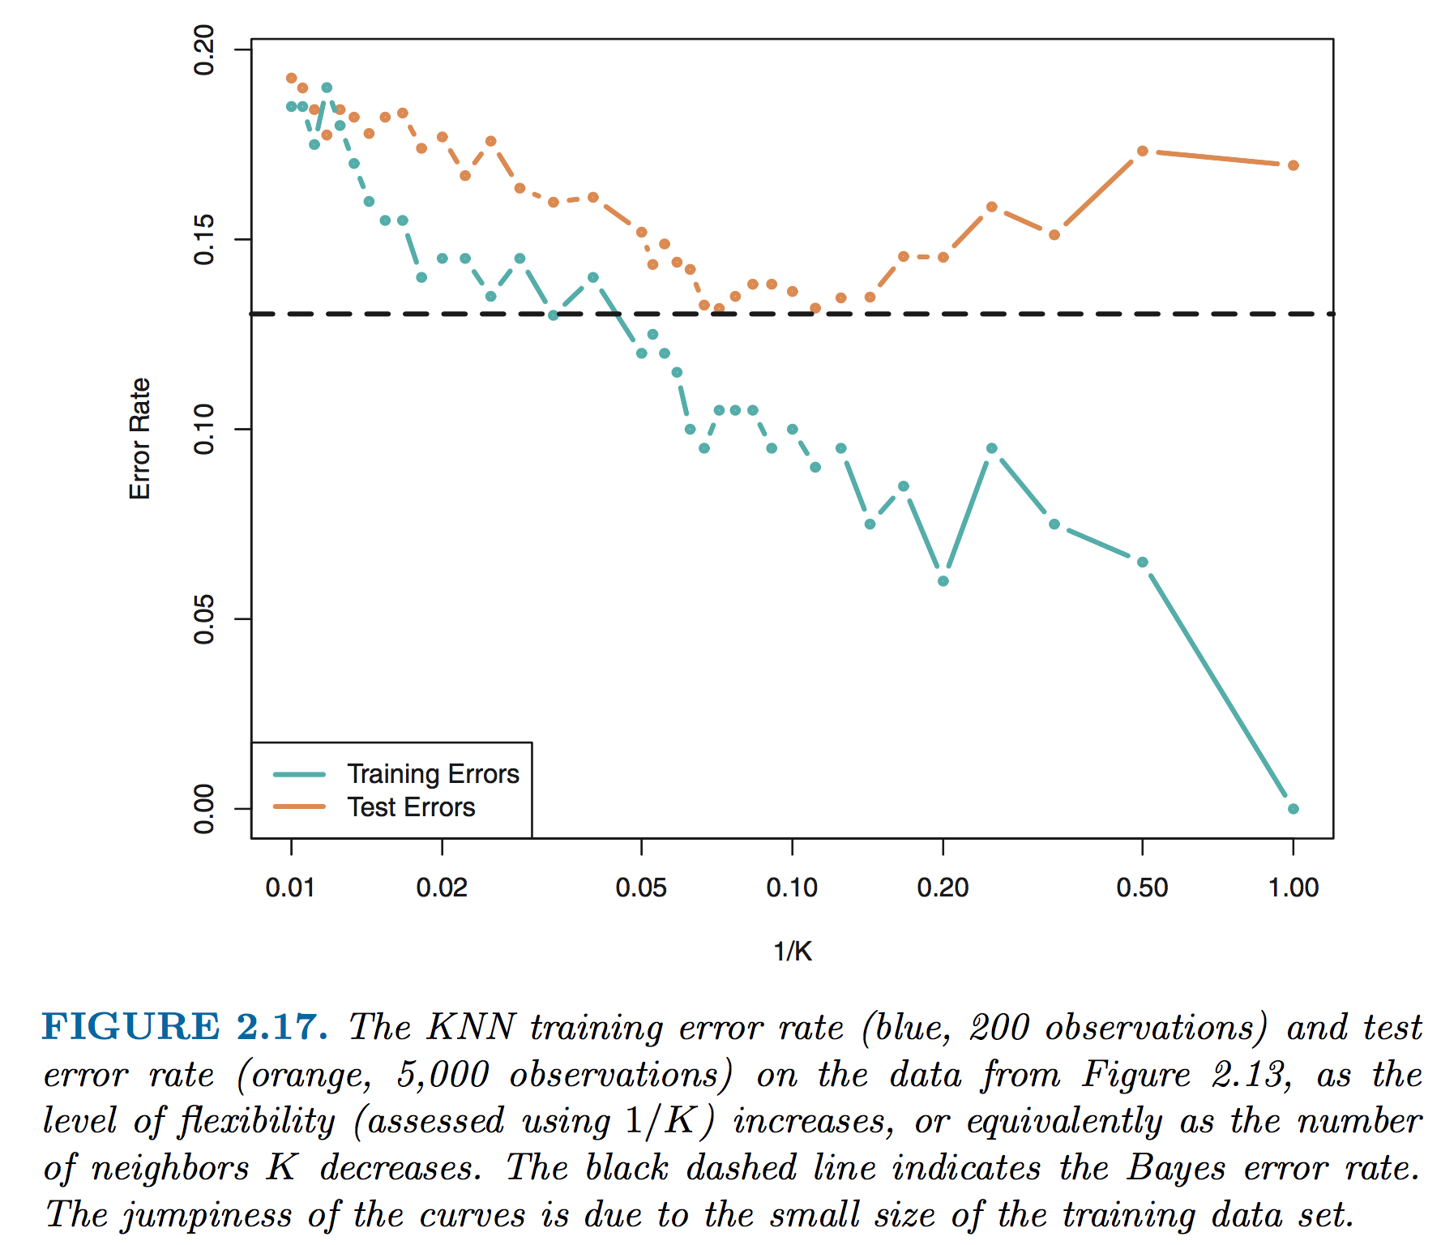
Effect of K on accuracy

Slide 24
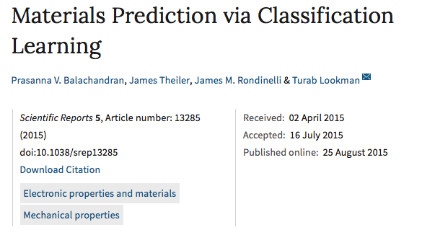
Practice with the KNN!
Lets get our hands dirty
The example data we are using come from the paper below
Much of the code comes from the scikit-learn KNN tutorial (http://scikit-learn.org/stable/tutorial/statistical_inference/supervised_learning.html)

Slide 25
With one partner (14x2!)
Get the notebook from the syllabus
Partner up
Hack away!

